Slide 1
Part of Speech Tagging
Jurafsky and Martin Chapter 8

Slide 2

Schoolhouse Rock
Notes:
https://www.youtube.com/watch?v=Qk4N5kkifGQ&list=PL2Th9LBsWQq7SWCgd4aMjSIIJkYwgGIZ-

Slide 3
Ancient Greek tag set
(c. 100 BC)
Noun
Verb
Pronoun
Preposition
Adverb
Conjunction
Participle
Article

Slide 4
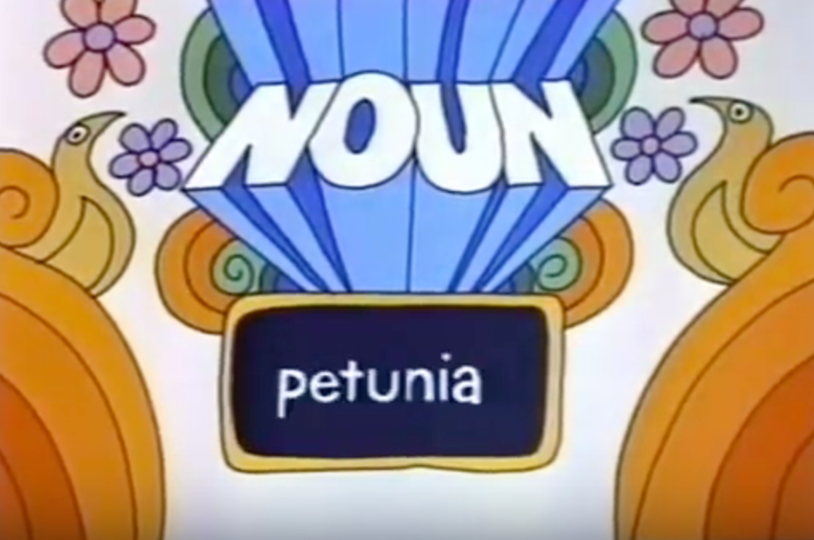
Schoolhouse Rock tag set
(c. 1970)
Noun
Verb
Pronoun
Preposition
Adverb
Conjunction
Participle
Article
Adjective
Interjection

Slide 5
Word classes
Every word in the vocabulary belongs to one or more of these word classes.
Assigning the classes to words in a sentence is called part of speech (POS) tagging.
Many words can have multiple POS tags. Can you think of some?

Slide 6
Open classes
Four major classes:
Noun
Verbs
Adjectives
Adverbs
English has all four but not every language does.

Slide 7
Nouns
Person, place or thing.
Proper nouns: names of specific entities or people.
Common nouns
Count nouns - allow grammatical enumeration, occurring in both singular and plural.
Mass nouns - conceptualized as homogenous groups. Cannot be pluralized. Can appear without determiners even in singular form.
Notes:
Proper nouns: Professor Marcus, University of Pennsylvania, NRA
Count nouns: cats, democracy, cereal. One cat, two cats.
Mass nouns: snow, salt, communism. *One snow, two snows. (grammatical)
The cat is cute. (grammatical)
*Cat is cute
Cats are cute
The snow is white.
Snow is white (grammatical)
Count nouns allow grammatical enumeration, occurring in both the singular and plural (goat/goats, relationship/relationships) and they can be counted (one goat, two goats). Mass nouns are used when something is conceptualized as a homogeneous group. So words like snow, salt, and communism are not counted (i.e., *two snows or *two communisms). Mass nouns can also appear without articles where singular count nouns cannot (Snow is white but not *Goat is white).

Slide 8
Verbs
Words describing actions and processes.
English verbs have inflectional markers.
3rd person singular
Non-3rd person singular
Progressive (ing)
Past
Notes:
compute
suffix
3rd person singular
He/she/it computes
+s
Non-3rd person singular
They/you/I compute

Slide 9
Verbs
Words describing actions and processes.
English verbs have inflectional markers.
 | Root: compute | suffix
3rd person singular | He/she/it computes | +s
Non-3rd person singular | They/you/I compute | __
Progressive (ing) | Computing | +ing
Past | Computed | +ed
Notes:
Compute
3rd person singular it computes +s
Non-3rd person singular
Progressive (ing)
Past

Slide 10
Adjectives
Word that describe properties or qualities.
Notes:
Qualtities: color, age, value (good/bad), material, subjective words (amazing)
Scalar adjectives.
Temperature: lukewarm < warm < hot < boiling < scalding < face-melting.
The interpretation of adjective-noun pairs plays a crucial role in tasks such as rec- ognizing textual entailment. Formal se- mantics often places adjectives into a taxonomy which should dictate adjec- tives’ entailment behavior when placed in adjective-noun compounds. However, we show experimentally that the behavior of subsective adjectives (e.g. red) versus non-subsective adjectives (e.g. fake) is not as cut and dry as often assumed. For ex- ample, inferences are not always symmet- ric: while ID is generally considered to be mutually exclusive with fake ID, fake ID is considered to entail ID. We discuss the im- plications of these findings for automated natural language understanding.
Privative Non-Subsective (AN \ N = ;)
anti- erstwhile false hypothetical imaginary mock onetime past phony simulated spurious virtual
deputy fake former mythical pseudo- would-be
artificial ex- fictional
counterfeit fabricated fictitious
Plain Non-Subsective (AN 6⇢ N and AN \ N 6= ;)
alleged believed dubious future likely possible probable seeming theoretical
apparent debatable erroneous historic mistaken potential proposed so-called uncertain
arguable disputed expected impossible ostensible predicted putative supposed unlikely
assumed doubtful faulty improbable plausible presumed questionable suspicious unsuccessful

Slide 11
Adverb
Modify verbs or whole verb phrases or other words like adjectives
Locatives
Degree
Manner
Temporal
Notes:
Locatives: here, home, uphill
Degree: Very, extremely, extraordinarily,
somewhat, not really, --ish
Manner: slowly / quickly, softly/gently, alluringly
Temporal: yesterday, Monday, Last semester

Slide 12
Closed Classes
numerals | one, two, nth, first, second, …
prepositions | of, on, over, under, to, from, around
determiners | indefinite: some, a, an definite: the, this, that, the
pronouns | she, he, it, they, them, who, whoever, whatever
conjunctions | and, or, but
particles (preposition joined to a verb) | knocked over
auxiliary verbs | was
Notes:
Auxiliary verbs:
Tense: when
Aspect: still going on?
Polarity negation
Mood, desirable./ possible suggeted

Slide 14
Corpora with manual POS tags
Brown corpus – 1 million words of 500 written English texts from different genres.
WSJ corpus – 1 million words from the Wall Street Journal
Switchboard corpus – 2 million words of telephone conversations

Slide 15
POS Tagging
Words are ambiguous, so tagging must resolve disambiguate.

Slide 16
Some words have up to 6 tags
 | Sentence | Tag
1 | Earnings took a back seat
2 | A small yard in the back
3 | Senators back the bill
4 | He started to back towards the door
5 | To buy back stock.
6 | I was young back then.
Notes:
Adj
Noun
Past tense verb
Infinitival verb
Verb+Particle
Adverb (temporal)

Slide 17
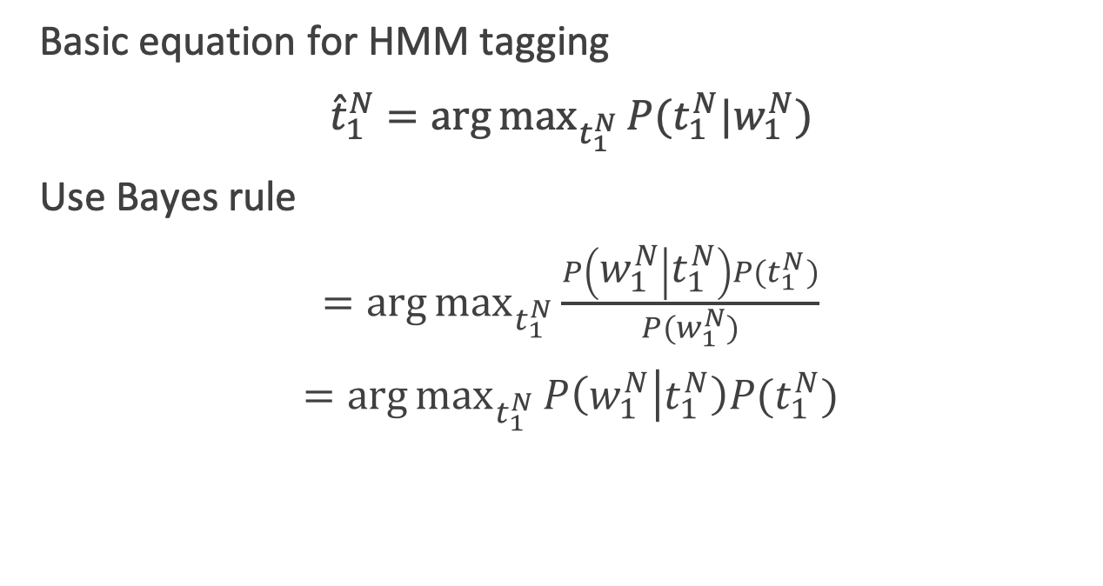
HMMs for tagging
Basic equation for HMM tagging
${\hat{t}}_{1}^{N}=\arg{\max_{t_{1}^{N}}{P(t_{1}^{N}|w_{1}^{N})}}$
Use Bayes rule
$=\arg{\max_{t_{1}^{N}}{\frac{P\left(w_{1}^{N} | t_{1}^{N}\right)P(t_{1}^{N})}{P(w_{1}^{N})}}}$
$=\arg{\max_{t_{1}^{N}}{P\left(w_{1}^{N} | t_{1}^{N}\right)P(t_{1}^{N})}}$
Notes:
Hidden Markov Models are trained on tagged corpora.
Fully supervised with MLE estimation

Slide 18
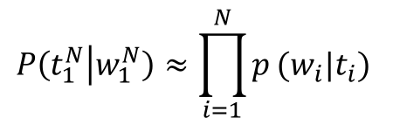
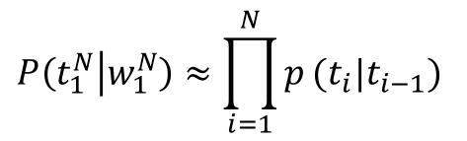
Simplifying Assumptions
Probability of a word only depends on its own tag, and it is intendent of neighboring word and tags
Bigram assumption. The probability of a tag depends only on previous tag, not the whole tag sequence.
$$P\left(t_{1}^{N} | w_{1}^{N}\right)≈\prod_{i=1}^{N}{p}(w_{i}|t_{i})$$
$$P\left(t_{1}^{N} | w_{1}^{N}\right)≈\prod_{i=1}^{N}{p}(t_{i}|t_{i−1})$$

Slide 19
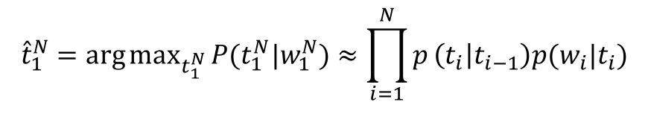
Simplifying Assumptions
Probability of a word only depends on its own tag, and it is intendent of neighboring word and tags
Bigram assumption. The probability of a tag depends only on previous tag, not the whole tag sequence.
$$P\left(t_{1}^{N} | w_{1}^{N}\right)≈\prod_{i=1}^{N}{p}(w_{i}|t_{i})$$
Emission probability
$$P\left(t_{1}^{N} | w_{1}^{N}\right)≈\prod_{i=1}^{N}{p}(t_{i}|t_{i−1})$$
Transition probability
Combining everything
$${\hat{t}}_{1}^{N}=\arg{\max_{t_{1}^{N}}{P(t_{1}^{N}|w_{1}^{N})}}≈\prod_{i=1}^{N}{p}\left(t_{i} | t_{i−1}\right)p(w_{i}|t_{i})$$

